Slide 1
Harrow Vaccination Update
Isha Coombes – Borough Director
10th February 2022

Slide 2
Key Messages
Harrow has delivered over 465,000 vaccinations to date - 179,000 first doses,167,000 second doses and 124,000 booster doses.
Demand for vaccinations more generally has dropped across the North West London with all pillars now seeing significant reductions in booked or walk-in appointments.
Refining the communications message for those that have not yet come forward is becoming harder and thus general thinking about how to reframe the vaccine offer within a wider discussion around health now being actively considered.
As part of the NHSE inequalities initiative we are working with general practices on innovative community engagement projects. General Practices have made over 5000 calls during the last 2-weeks, with 60% not being able to get through, 7% converting to bookings, and 6% confirming they decline the vaccination
Joint initiative between Harrow and Brent to support a mobile vaccination unit in Morrison’s car park on Honeypot Lane – the supermarket serves residents on the east of the borough and where there are communities with low rates of uptake
Started vaccinating clinically at risk 5-11s, clinics started 12 February 2022, to maximise uptake during the half term. In collaboration with Harrow Council and NWL communication team we have developed the following message which they have put out through their channels:
Vulnerable children aged 5-11 are now eligible for a dose of the Covid vaccine.
If you are a parent or guardian of a vulnerable child, your GP will be in touch with you about arranging an appointment at an approved site. Currently, you cannot book an appointment on the national booking system.
Find out more about the rollout of the vaccine to children aged 5-11.

Slide 3
1St dose as % of population
% Uptake | Brent | Central | Ealing | H&F | Harrow | Hillingdon | Hounslow | West London | Unknown | Total
Care Home Resident | 95.6% | 92.4% | 94.6% | 96.2% | 94.6% | 97.8% | 96.4% | 96.4% | 95.2% | 95.9%
Frontline healthcare worker (ESR) | 90.1% | 94.2% | 92.9% | 93.4% | 95.3% | 95.2% | 95.2% | 90.2% | 96.2% | 93.4%
Frontline healthcare worker (self declared) | 99.4% | 99.5% | 99.4% | 99.3% | 99.5% | 99.6% | 99.5% | 99.3% | 98.8% | 99.4%
80+ | 85.4% | 84.3% | 87.3% | 81.6% | 92.8% | 92.3% | 90.7% | 81.3% | 82.8% | 87.7%
75-79 | 85.7% | 83.2% | 89.1% | 83.1% | 92.6% | 93.4% | 90.6% | 81.1% | 83.5% | 88.0%
Clinically Extremely Vulnerable | 83.7% | 85.6% | 88.8% | 83.9% | 91.5% | 93.3% | 91.3% | 85.0% | 89.7% | 88.3%
70-74 | 83.4% | 77.1% | 86.6% | 81.2% | 90.6% | 91.3% | 87.8% | 77.9% | 75.1% | 85.1%
65-69 | 81.7% | 74.5% | 84.0% | 78.4% | 88.5% | 89.4% | 86.2% | 73.5% | 74.9% | 82.7%
Learning Disability Register | 78.6% | 76.2% | 82.7% | 77.2% | 86.3% | 87.4% | 85.5% | 77.7% | 85.7% | 82.1%
QCovid | 82.4% | 80.1% | 86.1% | 76.8% | 86.9% | 87.9% | 86.5% | 79.5% | 83.3% | 83.9%
DWP Carers | 69.5% | 71.3% | 75.9% | 64.8% | 78.2% | 78.2% | 78.0% | 67.3% | 77.2% | 73.6%
LA Carers | 76.8% | 80.1% | 82.8% | 65.1% | 88.7% | 85.1% | 88.5% | 72.7% | 85.7% | 81.8%
At Risk | 75.9% | 72.6% | 80.3% | 76.2% | 83.8% | 84.8% | 83.6% | 71.4% | 81.6% | 78.9%
60-64 | 73.2% | 67.0% | 77.8% | 72.1% | 83.7% | 85.1% | 80.8% | 65.2% | 66.2% | 75.8%
55-59 | 71.2% | 64.7% | 74.5% | 73.3% | 79.4% | 81.3% | 78.4% | 64.1% | 69.2% | 73.3%
50-54 | 68.3% | 62.2% | 72.6% | 70.8% | 76.2% | 78.7% | 76.3% | 61.6% | 61.8% | 70.7%
40-49 | 61.6% | 54.2% | 64.7% | 60.2% | 68.3% | 72.6% | 66.6% | 54.5% | 62.6% | 62.9%
30-39 | 54.3% | 51.7% | 58.4% | 61.3% | 58.6% | 65.8% | 58.6% | 53.7% | 66.3% | 57.8%
18-29 | 57.6% | 56.6% | 62.4% | 66.5% | 59.8% | 65.1% | 65.7% | 56.8% | 64.1% | 61.4%
12-17 Household contacts of immunosuppressed | 44.8% | 46.9% | 53.1% | 38.1% | 62.2% | 58.7% | 56.0% | 37.6% | 29.0% | 51.9%
16-17 | 49.4% | 48.4% | 55.1% | 44.6% | 60.6% | 61.2% | 60.0% | 44.4% | 58.2% | 54.0%
12-15 | 41.1% | 38.7% | 47.1% | 38.2% | 51.8% | 49.4% | 49.0% | 35.6% | 45.0% | 45.0%
Total | 65.5% | 61.6% | 70.0% | 67.4% | 73.4% | 76.2% | 72.0% | 62.0% | 71.4% | 68.6%

Slide 4
Borough Level – 2nd Dose as % of first dose
% Uptake | Brent | Central | Ealing | H&F | Harrow | Hillingdon | Hounslow | West London | Unknown | Total
Care Home Resident | 90.8% | 90.9% | 95.0% | 91.4% | 91.7% | 90.6% | 90.9% | 92.5% | 90.5% | 91.3%
Frontline healthcare worker (ESR) | 93.7% | 95.0% | 95.3% | 95.7% | 96.6% | 96.9% | 96.0% | 94.7% | 95.4% | 95.6%
Frontline healthcare worker (self declared) | 97.8% | 98.1% | 98.0% | 97.9% | 98.6% | 98.6% | 98.0% | 97.6% | 96.7% | 98.1%
80+ | 95.2% | 96.0% | 96.7% | 96.8% | 97.5% | 97.6% | 97.0% | 95.2% | 95.2% | 96.6%
75-79 | 97.0% | 95.6% | 97.6% | 96.2% | 98.2% | 98.5% | 97.8% | 95.8% | 98.1% | 97.3%
Clinically Extremely Vulnerable | 96.2% | 96.5% | 97.5% | 96.5% | 98.2% | 98.0% | 97.6% | 96.4% | 97.1% | 97.2%
70-74 | 96.9% | 94.9% | 97.5% | 96.7% | 98.1% | 98.0% | 97.6% | 96.2% | 94.9% | 97.2%
65-69 | 96.9% | 95.2% | 97.3% | 96.4% | 98.2% | 98.1% | 97.2% | 95.9% | 95.0% | 97.1%
Learning Disability Register | 91.9% | 91.1% | 94.2% | 90.1% | 94.7% | 96.1% | 94.2% | 94.4% | 94.4% | 93.6%
QCovid | 95.6% | 95.9% | 96.0% | 95.0% | 97.3% | 96.4% | 96.2% | 95.8% | 97.9% | 96.0%
DWP Carers | 92.4% | 93.3% | 93.2% | 91.4% | 94.8% | 94.2% | 93.2% | 93.6% | 94.9% | 93.3%
LA Carers | 94.6% | 95.6% | 94.1% | 94.0% | 95.7% | 96.4% | 98.2% | 93.7% | 90.5% | 95.7%
At Risk | 94.5% | 93.7% | 95.3% | 94.7% | 96.7% | 96.0% | 95.7% | 94.6% | 94.7% | 95.2%
60-64 | 96.1% | 94.4% | 97.0% | 96.0% | 98.1% | 97.9% | 97.2% | 95.1% | 93.2% | 96.6%
55-59 | 95.5% | 94.7% | 96.9% | 96.3% | 97.6% | 97.7% | 97.0% | 95.2% | 95.3% | 96.4%
50-54 | 95.5% | 95.1% | 96.5% | 95.6% | 97.3% | 97.3% | 96.9% | 95.1% | 94.2% | 96.2%
40-49 | 94.8% | 94.4% | 95.4% | 95.4% | 96.2% | 96.2% | 95.3% | 94.0% | 93.3% | 95.2%
30-39 | 92.7% | 92.7% | 93.0% | 94.6% | 94.0% | 93.7% | 93.0% | 92.7% | 89.7% | 93.3%
18-29 | 88.3% | 86.8% | 88.2% | 92.6% | 90.5% | 89.3% | 89.1% | 88.8% | 88.0% | 89.3%
12-17 Household contacts of immunosuppressed | 45.1% | 49.4% | 47.0% | 47.6% | 61.5% | 48.6% | 44.9% | 45.3% | 55.6% | 50.0%
16-17 | 65.9% | 69.9% | 64.0% | 67.8% | 71.4% | 69.6% | 69.3% | 67.3% | 58.9% | 67.8%
12-15 | 29.0% | 43.6% | 37.2% | 38.7% | 45.4% | 35.0% | 31.8% | 40.1% | 26.9% | 36.5%
Total | 91.3% | 91.4% | 91.9% | 93.5% | 93.5% | 92.9% | 92.0% | 92.2% | 90.4% | 92.3%

Slide 5
Booster Dose as % of 2nd Doses
% Uptake | Brent | Central | Ealing | H&F | Harrow | Hillingdon | Hounslow | West London | Unknown | Total
Care Home Resident | 73.4% | 75.9% | 77.8% | 73.1% | 78.1% | 79.3% | 75.5% | 76.1% | 69.3% | 75.5%
Frontline healthcare worker (ESR) | 74.7% | 81.2% | 78.4% | 81.4% | 81.5% | 82.1% | 80.9% | 79.1% | 80.7% | 79.9%
Frontline healthcare worker (self declared) | 68.5% | 75.0% | 69.7% | 73.1% | 77.0% | 74.1% | 71.9% | 74.0% | 64.0% | 72.5%
80+ | 80.6% | 84.6% | 86.4% | 83.0% | 88.3% | 88.6% | 87.2% | 84.7% | 82.1% | 85.8%
75-79 | 85.1% | 87.4% | 88.8% | 87.4% | 91.7% | 91.5% | 90.0% | 87.3% | 95.6% | 89.0%
Clinically Extremely Vulnerable | 69.4% | 70.4% | 75.7% | 70.5% | 78.7% | 75.8% | 79.4% | 72.5% | 72.3% | 74.8%
70-74 | 87.2% | 88.5% | 90.3% | 89.6% | 93.4% | 93.7% | 92.1% | 87.5% | 87.0% | 90.6%
65-69 | 85.9% | 86.2% | 87.6% | 85.8% | 92.4% | 91.9% | 90.5% | 85.1% | 86.2% | 88.5%
Learning Disability Register | 69.4% | 69.5% | 68.2% | 71.7% | 84.7% | 77.1% | 74.6% | 64.5% | 52.9% | 72.9%
QCovid | 69.0% | 71.9% | 69.7% | 68.0% | 78.8% | 74.9% | 73.4% | 68.5% | 68.8% | 71.6%
DWP Carers | 55.6% | 52.0% | 61.1% | 59.0% | 70.1% | 67.1% | 65.5% | 53.6% | 64.9% | 61.3%
LA Carers | 73.8% | 60.7% | 63.9% | 68.6% | 87.4% | 80.2% | 80.8% | 64.0% | 68.4% | 75.5%
At Risk | 70.9% | 73.5% | 72.9% | 74.1% | 81.6% | 78.4% | 76.5% | 73.2% | 73.5% | 75.1%
60-64 | 79.3% | 83.5% | 84.0% | 82.8% | 89.1% | 89.5% | 86.0% | 81.9% | 83.5% | 84.6%
55-59 | 74.3% | 80.7% | 79.8% | 81.5% | 86.2% | 86.2% | 82.0% | 79.9% | 78.9% | 81.1%
50-54 | 70.1% | 77.9% | 73.2% | 77.1% | 82.4% | 81.2% | 77.1% | 76.0% | 71.4% | 76.4%
40-49 | 61.7% | 70.5% | 63.8% | 70.9% | 73.2% | 69.8% | 66.1% | 69.1% | 60.6% | 67.4%
30-39 | 53.3% | 63.6% | 54.7% | 66.2% | 63.8% | 57.9% | 55.2% | 60.5% | 52.0% | 59.2%
18-29 | 42.4% | 55.7% | 43.7% | 58.9% | 52.2% | 46.2% | 44.7% | 51.4% | 43.1% | 49.8%
12-17 Household contacts of immunosuppressed | 9.4% | 8.8% | 5.5% | 4.5% | 6.8% | 7.1% | 6.6% | 9.1% | 0.0% | 7.1%
16-17 | 11.8% | 12.5% | 11.3% | 12.7% | 9.9% | 10.6% | 11.2% | 12.7% | 1.6% | 11.3%
12-15 | 0.4% | 0.4% | 0.1% | 0.0% | 0.0% | 0.0% | 0.2% | 0.1% | 2.2% | 0.1%
Total | 62.9% | 68.8% | 65.8% | 68.5% | 74.0% | 71.2% | 67.9% | 68.9% | 61.8% | 68.1%

Slide 6
Borough Level – 3rd Dose for immunosuppressed as % of 2nd dose
% Uptake | Brent | Central | Ealing | H&F | Harrow | Hillingdon | Hounslow | West London | Total
Immunosupression (16-64) | 74.30% | 85.31% | 80.28% | 82.58% | 86.61% | 85.86% | 81.58% | 84.11% | 82.35%
Harrow has the highest uptake (86.29%) of 3rd doses for the immunosuppressed 16-64 cohort.
A further 552 3rd doses have been delivered for immunosuppressed patients included within other cohort

Slide 7
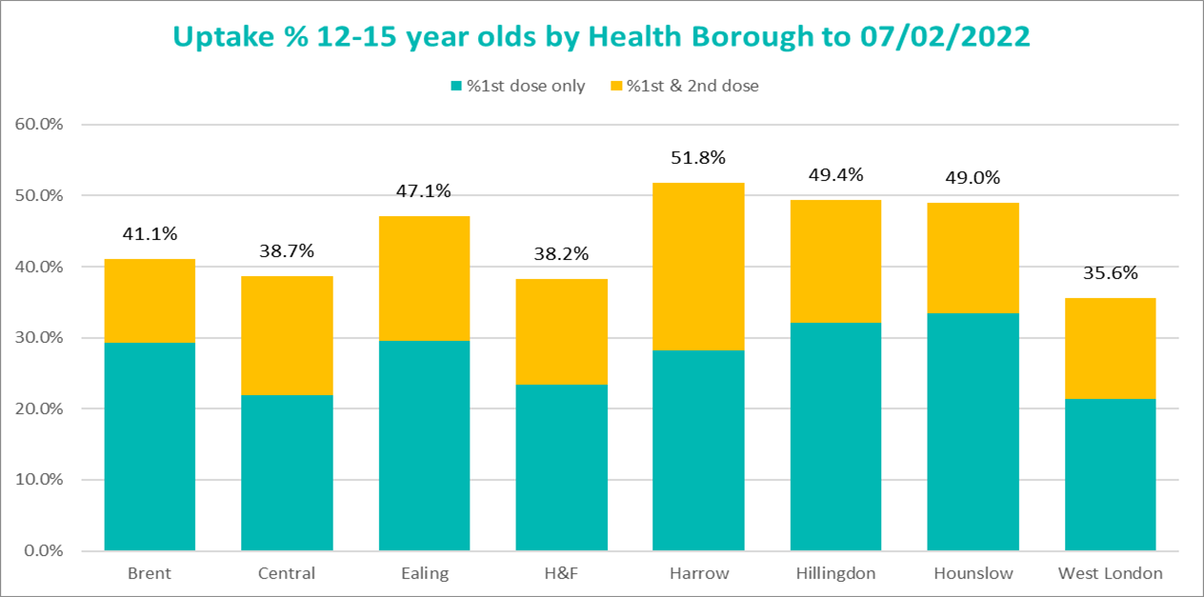
12-15 year olds uptake by Health Boroughs

